Slide 1
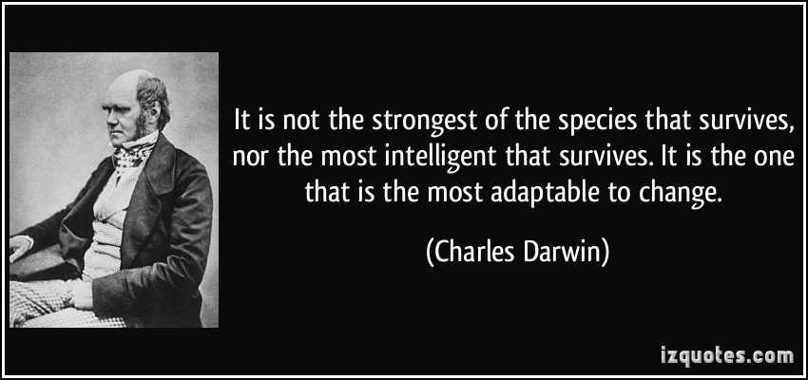

Slide 2
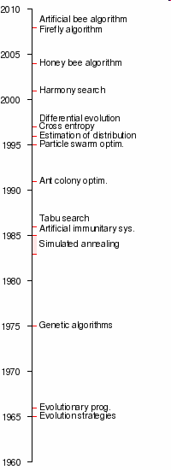
Evolutionary Computation
Meta-heuristics is a heuristic method for solving a very general class of computational problems by combining user-given black-box procedures — usually heuristics themselves — in the hope of obtaining a more efficient or more robust procedure.
Evolutionary computation is a family of algorithms for optimization inspired by biological evolution, and the subfield of artificial intelligence . In technical terms, they are a family of population-based trial and error problem solvers with a metaheuristic or stochastic optimization character.--Wikipedia

Slide 3

EC Family
GA: Genetic Algorithm
GP: Genetic Programming
ES: Evolution Strategies
EP: Evolutionary Programming
EDA: Estimation of Distribution Algorithm
PSO: Particle Swarm Optimization
ACO: Ant Colony Optimization
DE: Differential Evolution

Slide 4

Solution: Parallel Search
Conduct searching in different areas simultaneously.
Population Based
Avoid unfortunate starting positions.
Employ heuristic methods to effectively explore the space.
Focus on promising areas.
Also keep an eye on other regions.
More than random restart strategies.
This is where EAs come into play!

Slide 5
Framework of EC
Evolutionary Search
Evaluate
Select
Crossover
Mutate
Coding
Objective Function
Domain Knowledge
Problem

Slide 6




People
Prof. Xin Yao
南方科技大学，The University of Birmingham
www.cercia.ac.uk
Former EiC: IEEE Transactions on Evolutionary Computation
Former President of the IEEE Computational Intelligence Society
Dr. David Fogel
Natural Selection Inc.
www.natural-selection.com
Blondie24: Playing at the Edge of AI
Prof. Zbigniew Michalewicz
University of Adelaide
www.solveitsoftware.com
How to Solve It: Modern Heuristics

Slide 7
People
Prof. David E. Goldberg
University of Illinois at Urbana-Champaign
http://www.davidegoldberg.com/
Genetic Algorithms in Search, Optimization and Machine Learning (1989)
Prof. Kenneth A. De Jong
George Mason University
www.cs.gmu.edu/~eclab
De Jong Test Suite (PhD Thesis, 1975)
Evolutionary Computation: A Unified Approach (MIT Press, 2006)
Prof. A.E. EIBEN
Vrije Universiteit Amsterdam
https://www.cs.vu.nl/~gusz/
Introduction to Evolutionary Computing（2015，2nd）
A.E. Eiben and J. Smith, From evolutionary computation to the evolution of things, Nature, 2015, 521:476-482.

Slide 8
Genetic Algorithms
“Genetic Algorithms are good at taking large, potentially huge search spaces and navigating them, looking for optimal combinations of things, solutions you might not otherwise find in a lifetime.”
- Salvatore Mangano
Computer Design, May 1995

Slide 9
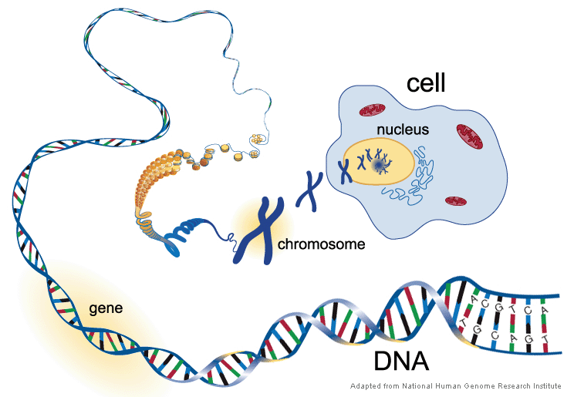
Biology Background

Slide 10
Biology Background
Gene
A working subunit of DNA
Gene Trait
For example: colour of eyes
Allele
Possible settings for a trait (e.g., Blown, Gray and Blue)
Genotype
The actual genes carried by an individual
Phenotype
The physical characteristics into which genes are translated

Slide 11
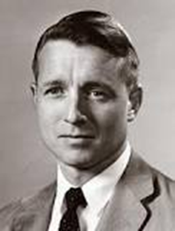
The Genetic Algorithm
Directed search algorithms based on the mechanics of biological evolution
Developed by John Holland, University of Michigan
Adaptation in Natural and Artificial Systems,1975
To understand the adaptive processes of natural systems
To design artificial systems software that retains the robustness of natural systems

Slide 12
The Genetic Algorithm (cont.)
Provide efficient, effective techniques for optimization and machine learning applications
Widely-used today in business, scientific and engineering circles

Slide 13
Components of a GA
A problem to solve, and ...
Encoding technique (gene, chromosome)
Initialization procedure (creation)
Evaluation function (environment)
Selection of parents (reproduction)
Genetic operators (mutation, recombination)
Parameter settings (practice and art)

Slide 14
Simple Genetic Algorithm
{
initialize population;
evaluate population;
while TerminationCriteriaNotSatisfied
{
select parents for reproduction;
perform recombination and mutation;
evaluate population;
}
}

Slide 15
The GA Cycle of Reproduction
children
reproduction
modification
modified
children
parents
population
evaluation
evaluated children
deleted
members
discard

Slide 16
Population
population
Chromosomes could be:
Bit strings (0101 ... 1100)
Real numbers (43.2 -33.1 ... 0.0 89.2)
Permutations of element (E11 E3 E7 ... E1 E15)
Lists of rules (R1 R2 R3 ... R22 R23)
Program elements (genetic programming)
... any data structure ...

Slide 17
Reproduction
children
reproduction
parents
population
Parents are selected at random with selection chances biased in relation to chromosome evaluations.

Slide 18
Chromosome Modification
Modifications are stochastically triggered
Operator types are:
Mutation
Crossover (recombination)
children
modification
modified children

Slide 19
Mutation: Local Modification
Before: (1 0 1 1 0 1 1 0)
After: (0 1 1 0 0 1 1 0)
Before: (1.38 -69.4 326.44 0.1)
After: (1.38 -67.5 326.44 0.1)
Causes movement in the search space (local or global)
Restores lost information to the population

Slide 20
Crossover: Recombination
*
P1 (0 1 1 0 1 0 0 0) (0 1 0 0 1 0 0 0) C1
P2 (1 1 0 1 1 0 1 0) (1 1 1 1 1 0 1 0) C2
Crossover is a critical feature of genetic
algorithms:
It greatly accelerates search early in evolution of a population
It leads to effective combination of schemata (subsolutions on different chromosomes)

Slide 21
Evaluation
The evaluator decodes a chromosome and assigns it a fitness measure
The evaluator is the only link between a classical GA and the problem it is solving
modified
children
evaluated
children
evaluation

Slide 22
Deletion
population
Generational GA: entire populations replaced with each iteration
Steady-state GA: a few members replaced each generation
discarded members
discard

Slide 23
An Abstract Example
Distribution of Individuals in Generation 0
Distribution of Individuals in Generation N

Slide 24
A Simple Example
“The Gene is by far the most sophisticated program around.”
- Bill Gates, Business Week, June 27, 1994

Slide 25
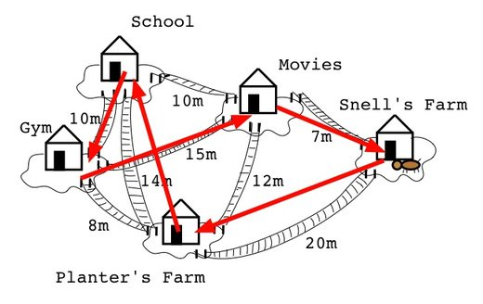
Example One
The Traveling Salesman Problem:
Find a tour of a given set of nodes so that
each node is visited only once
the total distance traveled is minimized

Slide 26
Representation
Representation is an ordered list of city
numbers known as an order-based GA.
1) London 3) Dunedin 5) Beijing 7) Tokyo
2) Venice 4) Singapore 6) Phoenix 8) Victoria
CityList1 (3 5 7 2 1 6 4 8)
CityList2 (2 5 7 6 8 1 3 4)

Slide 27
Crossover
Crossover combines inversion and
recombination:
* *
Parent1 (3 5 7 2 1 6 4 8)
Parent2 (2 5 7 6 8 1 3 4)
Child (5 8 7 2 1 6 3 4)
This operator is called the Order1 crossover.

Slide 28
Mutation
Mutation involves reordering of the list:
* *
Before: (5 8 7 2 1 6 3 4)
After: (5 8 6 2 1 7 3 4)

Slide 29
TSP Example: 30 Cities

Slide 30
Solution _{i} (Distance = 941)

Slide 31
Solution _{j}(Distance = 800)

Slide 32
Solution _{k}(Distance = 652)

Slide 33
Best Solution (Distance = 420)

Slide 34
Overview of Performance

Slide 35
Example: the 8 queens problem
Place 8 queens on an 8x8 chessboard in
such a way that they cannot check each other

Slide 36
Representation
Phenotype:
a board configuration
Genotype:
a permutation of
the numbers 1 - 8
Obvious mapping
1
3
5
2
6
4
7
8

Slide 37
Fitness evaluation
Penalty of one queen:
the number of queens she can check.
Penalty of a configuration:
the sum of the penalties of all queens.
Note: penalty is to be minimized
Fitness of a configuration:
inverse penalty to be maximized

Slide 38
Mutation
Small variation in one permutation, e.g.:
swapping values of two randomly chosen positions,
1
3
5
2
6
4
7
8
1
3
7
2
6
4
5
8

Slide 39
Recombination
Combining two permutations into two new permutations:
choose random crossover point
copy first parts into children
create second part by inserting values from other parent:
in the order they appear there
beginning after crossover point
skipping values already in child
1
3
5
2
6
4
7
8
1
3
5
4
2
8
7
6
8
7
6
5
4
3
2
1
8
7
6
2
4
1
3
5

Slide 40
The 8 queens problem: Selection
Parent selection:
Pick 5 parents and take best two to undergo crossover
Survivor selection (replacement)
When inserting a new child into the population, choose an existing member to replace by:
sorting the whole population by decreasing fitness
enumerating this list from high to low
replacing the first with a fitness lower than the given child

Slide 41
Considering the GA Technology
“Almost eight years ago ... people at Microsoft wrote a program [that] uses some genetic things for finding short code sequences. Windows 2.0 and 3.2, NT, and almost all Microsoft applications products have shipped with pieces of code created by that system.”
- Nathan Myhrvold, Microsoft Advanced Technology Group, Wired, September 1995

Slide 42
Issues for GA Practitioners
Choosing basic implementation issues:
representation
population size, mutation rate, ...
selection, deletion policies
crossover, mutation operators
Termination Criteria
Performance, scalability
Solution is only as good as the evaluation function (often hardest part)

Slide 43
Benefits of Genetic Algorithms
Concept is easy to understand
Modular, separate from application
Supports multi-objective optimization
Good for “noisy” environments
Always an answer; answer gets better with time
Inherently parallel; easily distributed

Slide 44
Benefits of Genetic Algorithms (cont.)
Many ways to speed up and improve a GA-based application as knowledge about problem domain is gained
Easy to exploit previous or alternate solutions
Flexible building blocks for hybrid applications
Substantial history and range of use

Slide 45
When to Use a GA
Alternate solutions are too slow or overly complicated
Need an exploratory tool to examine new approaches
Problem is similar to one that has already been successfully solved by using a GA
Want to hybridize with an existing solution
Benefits of the GA technology meet key problem requirements

Slide 46
Some GA Application Types

Slide 47

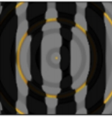
Recent Interesting Results
Can AI be fooled？
Is a penguin in the two pictures above?
---Yes for both by Deep Neural Network (DNN)
The right picture generated by a GA
Nguyen, A., J. Yosinski, and J. Clune. “Deep Neural Networks Are Easily Fooled: High Confidence Predictions for Unrecognizable Images.” In 2015 IEEE Conference on Computer Vision and Pattern Recognition ,427–36, 2015.

Slide 48
EAs make a Comeback
For supervised learning, gradient-based approaches work well
For reinforcement learning(RL), data typically is not iid (independent and identically distributed), error signals are sparser. EAs can scale linearly to thousands of machines enabling extremely fast parallel training.
Evolution strategies can achieve performance comparable to standard RL such as Deep Q-Learning.
---- AI and Deep Learning in 2017 – A Year in Review--- DECEMBER 31, 2017 BY DENNY BRITZ

Slide 49
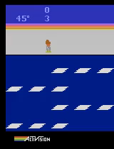
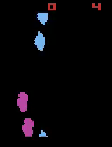
Genetic algorithms as a competitive alternative for training deep neural networks
This GA policy scores 10,500 on Frostbite. DQN, AC3, and ES score less than 1,000 on this game.
The GA plays Asteroids well. It outperforms DQN and ES on average, but not A3C.

Slide 50
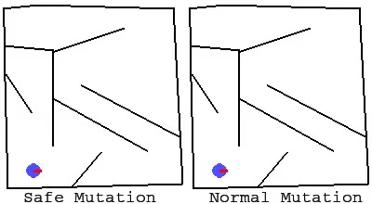
Safe mutations through gradient computations
Both animations show a batch of mutations of a single network that could solve the maze (with start at lower left and goal at upper left). Normal mutations mostly lose the ability to reach the end while safe mutations largely preserve it while still yielding diversity, illustrating the significant advantage of mutating safely.

Slide 51
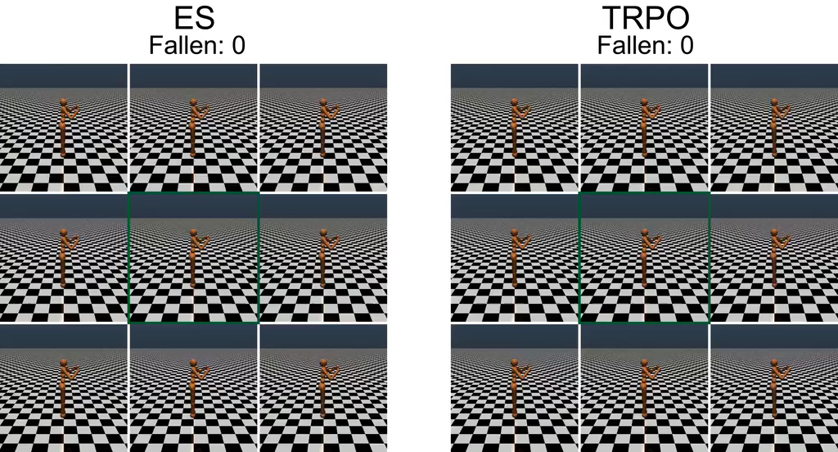
How ES relates to stochastic gradient descent (SGD)
Random perturbations of the weights of a walker learned by TRPO lead to significantly less stable gaits than random perturbations of a walker of equivalent quality evolved by ES. The original learned walkers are at the center of each nine-frame composite.

Slide 52
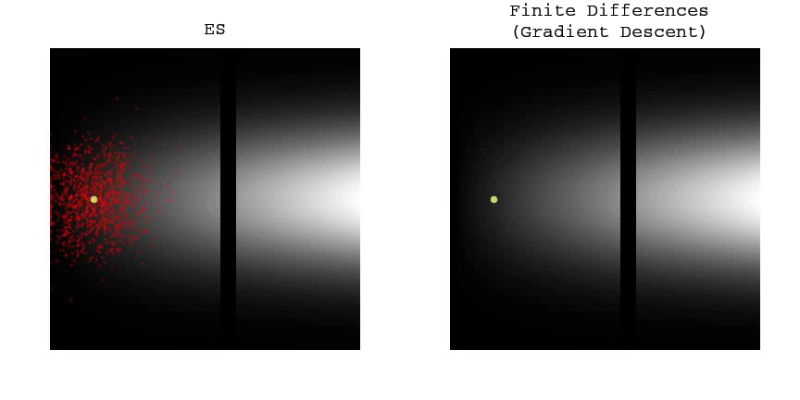
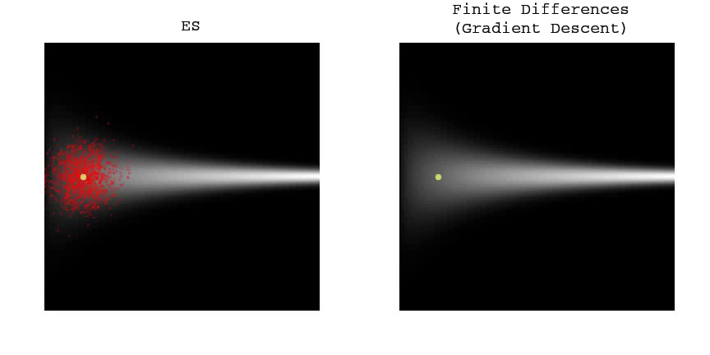
ES is not just traditional finite differences
Traditional finite differences (gradient descent) cannot cross a narrow gap of low fitness while ES easily crosses it to find higher fitness on the other side.
ES stalls as a path of high fitness narrows, while traditional finite differences (gradient descent) traverses the same path with no problem, illustrating along with the previous video the distinction and trade-offs between the two different approaches.

Slide 53
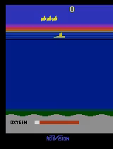
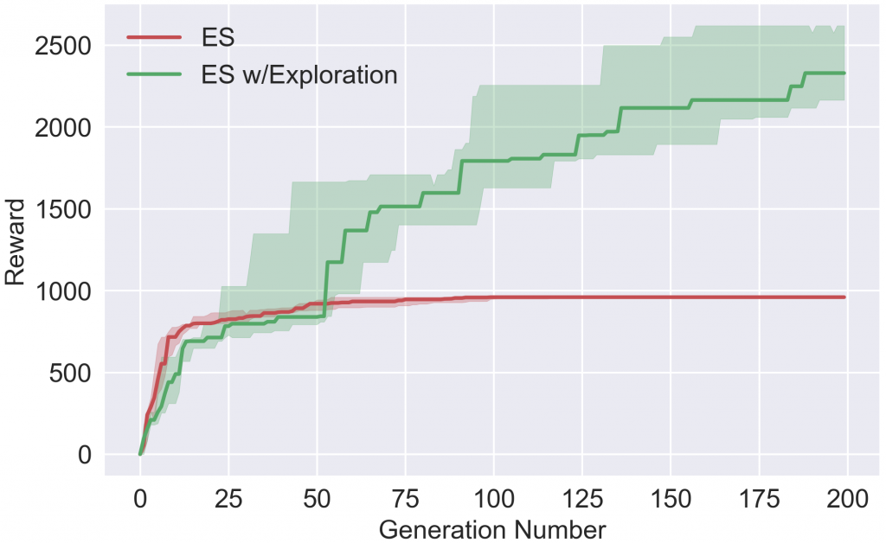
Improving exploration in ES
ES ES w/ Exploration Reward During Training
With our hyperparameters, ES converges quickly to a local optimum of not coming up for oxygen because doing so temporarily foregoes earning reward. With exploration, however, the agent learns to come up for oxygen and thus accrue much higher rewards in the future.

Slide 54
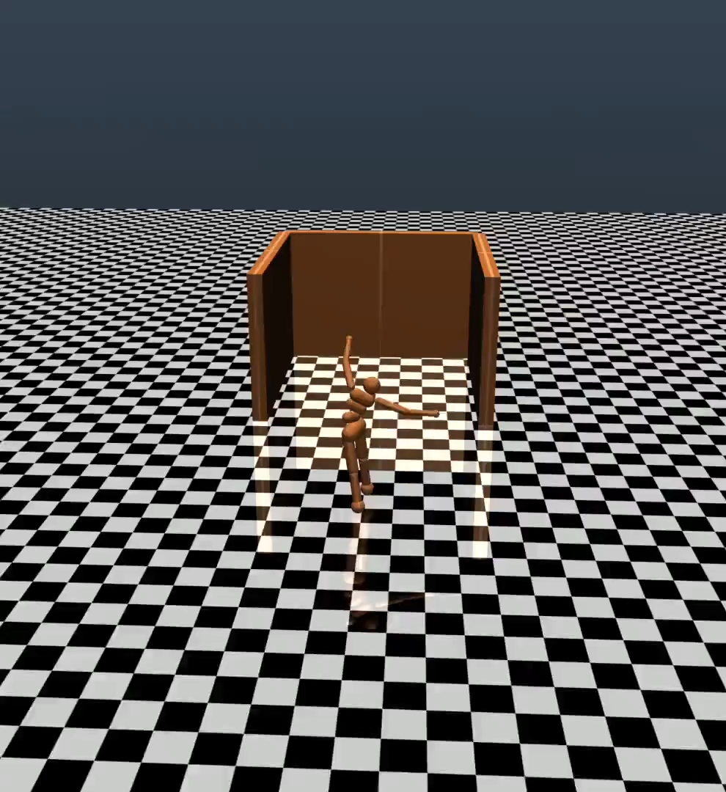
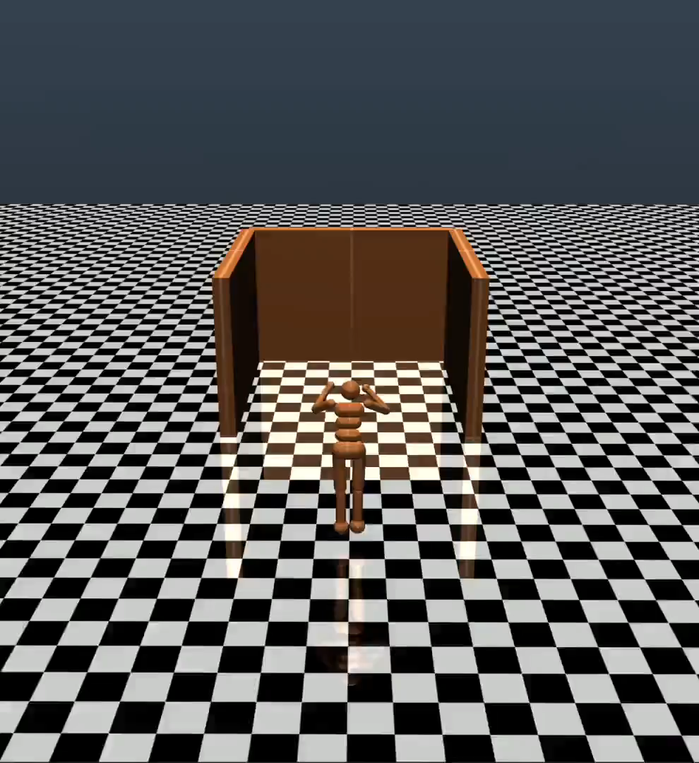
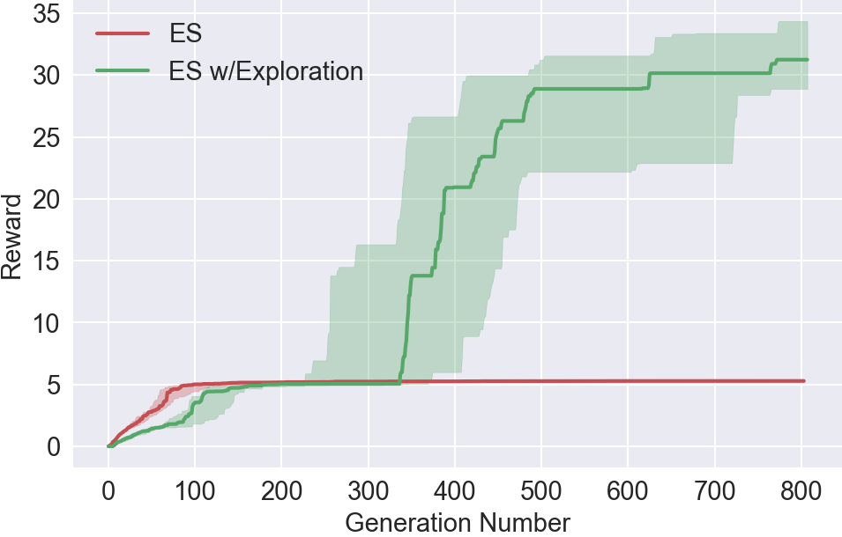
Improving exploration in ES
ES ES w/ Exploration Reward During Training
The agent is tasked with running as far forward as it can. ES never learns to escape the deceptive trap. With a pressure to explore, however, one of the agents learns to navigate around the trap.

Slide 55
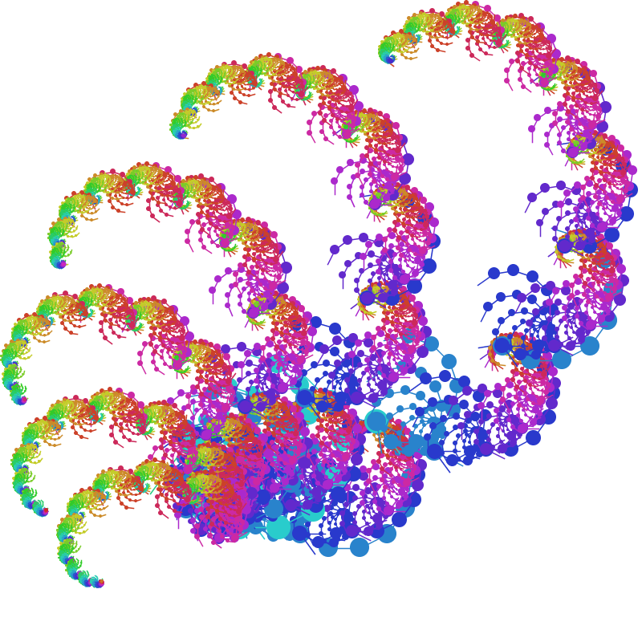
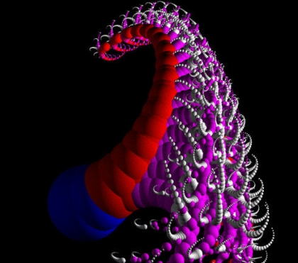
Evolutionary Art

Slide 56

Evolutionary Music
http://www.geneffects.com/musing/

Slide 57
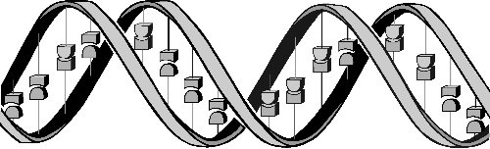
Conclusions
Question: ‘If GAs are so smart, why ain’t they rich?’
Answer: ‘Genetic algorithms are rich - rich in application across a large and growing number of disciplines.’
- David E. Goldberg, Genetic Algorithms in Search, Optimization and Machine Learning

